Slide 1

MULTI BANKING SYSTEM
DHANUSHYA R
III BSC CS
Guided by Dr.KOKILA MCA.,M.Phil,Ph.D

Slide 2
abstract
Nowadays the use of bank applications has increased and many banking operations are done online. In this paper we proposed a multi banking system using web services (for transactions).
The Multi Banking System acts as a standard interface between the clients and all the banks , by using this portal any client who maintain accounts in various banks can directly log on to Multi Banking System interface and make any kind of transactions.

Slide 3
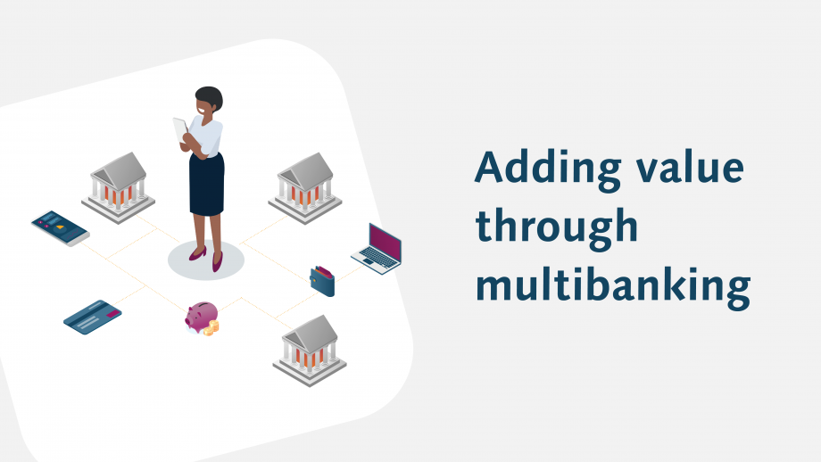
objective
The objective of this application is to allow the Customers of various Banks access their accounts and make transactions using this solution. They need not interact with various bank applications or web sites. The customer can login with single id and password.

Slide 4
HARDWARE SPECFICATION
Processor : P 4 700 GHz.
RAM : 4 GB RAM
Hard Disk Drive : 180 GB

Slide 5
SOFTWARE SPECIFICATION software specification
Operating System : Windows 10
Front End : PYTHON
Back End : SQL

Slide 6
EXISTING SYSTEM
Currently we are having lot of banks in the market and any person can do transactions of any individual bank either manually or in online. But no one can do all banks transactions in a single portal or in single bank.
Disadvantages
Customer need to use multi software for different account
Waste of time for just create an bank account

Slide 7
PROPOSED SYSTEM
The Multi Banking System Interface is targeted to the future banking solution for the users who is having multiple bank accounts in multiple banks. This interface integrates all existing banks and provides business solutions for both retail and corporate.
Advantages
By using this portal any client who maintain accounts in various banks can directly log on to Multi Banking System Interface and make any kind of transactions.
Can access different bank account details in an single application
In addition to this, the customer has certain privileges such as they can view there transaction and account details and also make fund transfers from one bank account to other.
Also, user can create various bank account in a single application

Slide 8
modules
Bank Registration
Manager Registration
Customer Registration
Approve and Reject Registration
Create Bank Account
Customer Detail Report

Slide 9
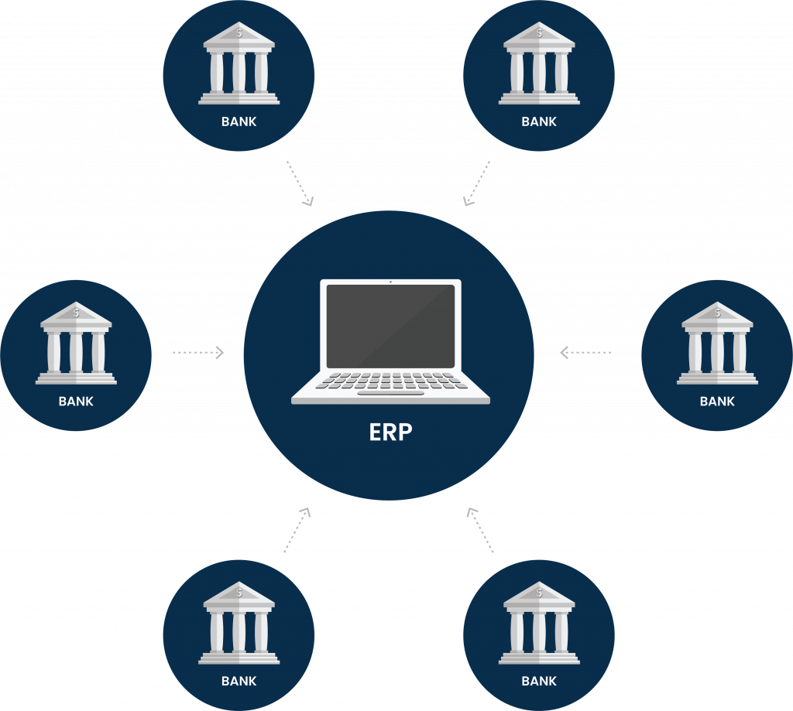
Bank registration
Admin first login into the banking system and create linked bank details, once the admin creates the bank it will shown in the all the requested places.
Admin provide all the information about the bank.

Slide 10

Manager registration
Admin also have access to create manager under respective banks.
This is a big process to add the manager details.
Once the manager allots to the bank, he gave access to managing the customer details.

Slide 11

Customer registration
Customer manually select the bank and give request to the respective bank manager; manager decide to check
the customer details and give approve request. Once the customer got access the account will be created

Slide 12

Approve and reject
This module will be handling by the bank manager, once manager get customer account request, just verified and do the action for approve or reject.

Slide 13

Create bank account
By default, it will create after the manager approving customer request. Once the account has created the customer can able to login and check the account details.

Slide 14

Customer details report
Manager can view the all the customer details as well in a single window. Once the customer has approved status the customer has shown in this window.

Slide 15

Data Flow Diagram
Level 0

Slide 16
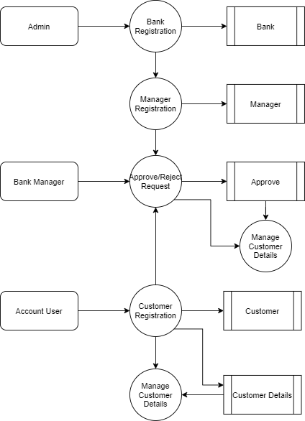
Level 1:

Slide 17
TABLE DESIGN TABLE NAME : ADMIN
FIELD | DATATYPE | SIZE | CONSTRAINT
Admin id | Int | 10 | Primary key
Username | Varchar | 25 | Not Null
Password | Varchar | 25 | Not Null

Slide 18
TABLE NAME : BANK
FIELD | DATATYPE | SIZE | CONSTRAINT
Bank id | Int | 10 | Primary key
Bank Name | Varchar | 30 | Not Null
Branch Name | Varchar | 30 | Not Null
Address | Varchar | 50 | Not Null
Landline | Int | 15 | Not Null
IFSC Code | Varchar | 10 | Not Null

Slide 19
TABLE NAME : MANAGER
FIELD | DATA TYPE | SIZE | CONSTRAINT
Manager id | Int | 10 | Primary key
Bank id | Int | 10 | Foreign key
Branch Name | Varchar | 30 | Not Null
Mobile | Int | 10 | Not Null
Landline | int | 10 | Not Null

Slide 20
Table name : customer
FIELD | DATA TYPE | SIZE | CONSTRAINT
Customer id | Int | 10 | Primary key
First Name | Varchar | 20 | Not Null
Last Name | Varchar | 20 | Not Null
Mobile | Int | 10 | Not Null
Aadhar | Int | 15 | Not Null
License | Varchar | 20 | Not Null
Age | Int | 2 | Not Null
Gender | Varchar | 7 | Not Null
Address 1 | Varchar | 30 | Not Null
Address 2 | Varchar | 30 | Not Null
City | Varchar | 20 | Not Null
State | Varchar | 20 | Not Null
Pincode | Int | 6 | Not Null

Slide 21
TABLE NAME : TRANSACTION
FIELD | DATATYPE | SIZE | CONSTRAINT
Customer id | Int | 10 | Primary key
First Name | Varchar | 25 | Not Null
Last name | Varchar | 25 | Not Null
Mobile | Int | 10 | Not Null
Aadhar | Int | 15 | Not Null
License | Varchar | 20 | Not Null
Age | Int | 2 | Not Null
Gender | Varchar | 7 | Not Null
Address 1 | Varchar | 30 | Not Null
Address 2 | Varchar | 30 | Not Null
City | Varchar | 20 | Not Null
State | Varchar | 20 | Not Null

Slide 22
TABLE NAME : APPROVE
FIELD | DATA TYPE | SIZE | CONSTRAINT
Approve id | Int | 10 | Primary key
Bank id | Int | 10 | Foreign key
Customer id | Int | 10 | Foreign key
Approve status | Varchar | 7 | Not null

Slide 23
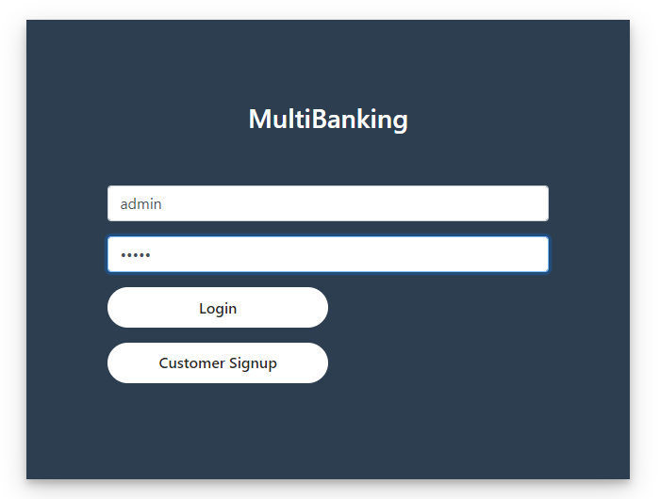
Admin login

Slide 24
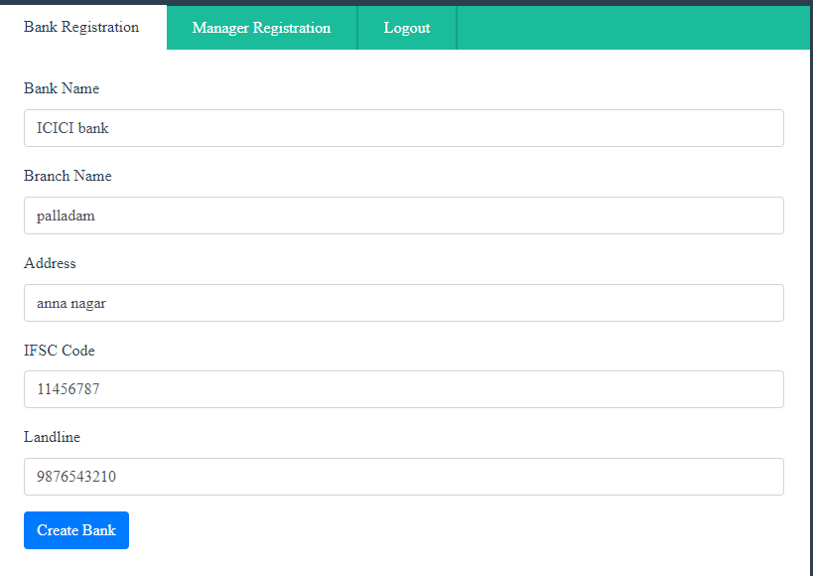
Bank registration

Slide 25
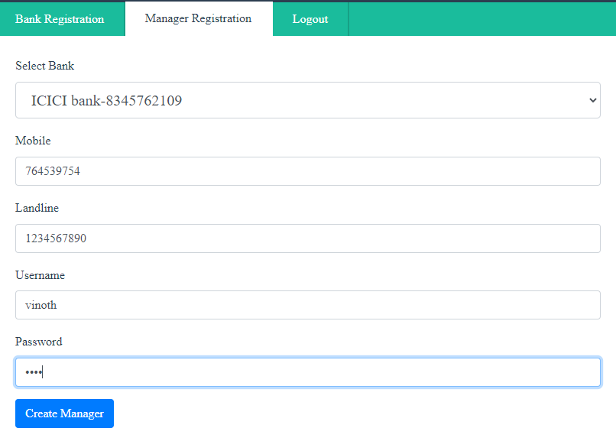
Manager registration

Slide 26
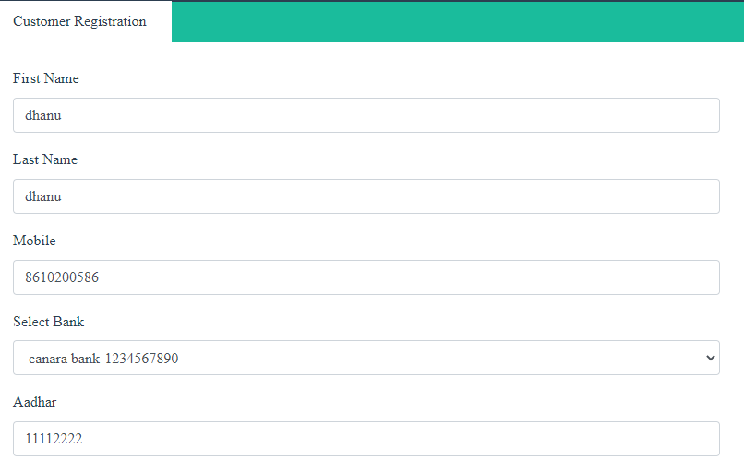
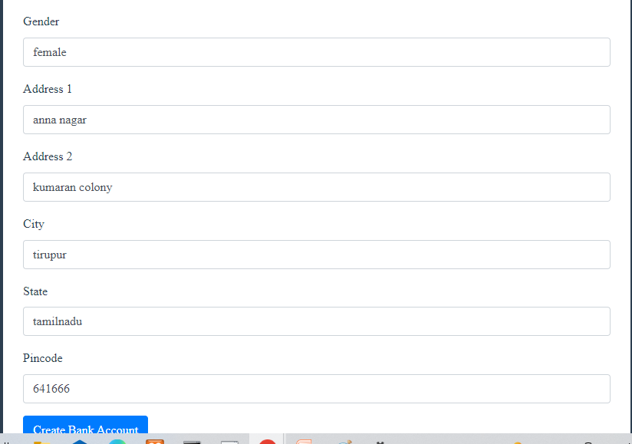
Customer registration

Slide 27
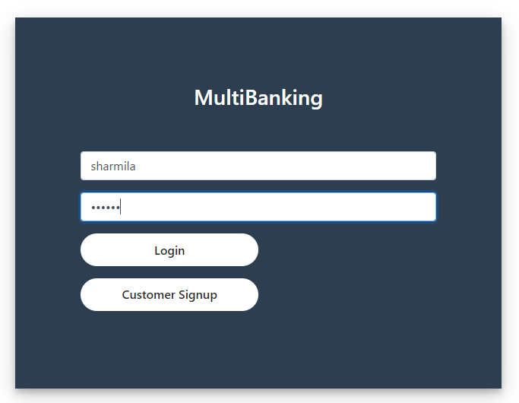
Manager login

Slide 28
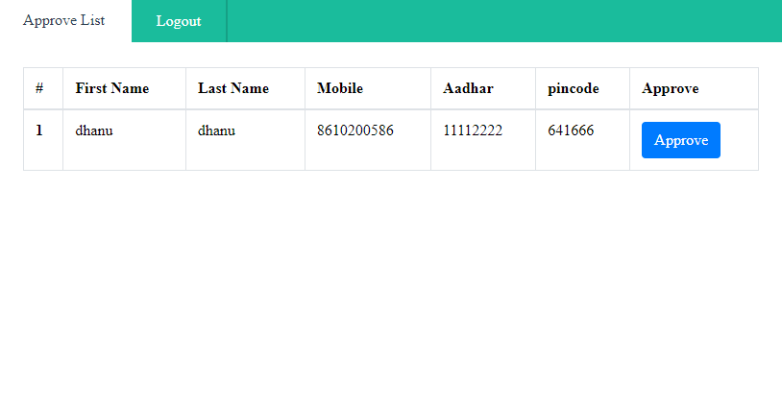
Approve list

Slide 29
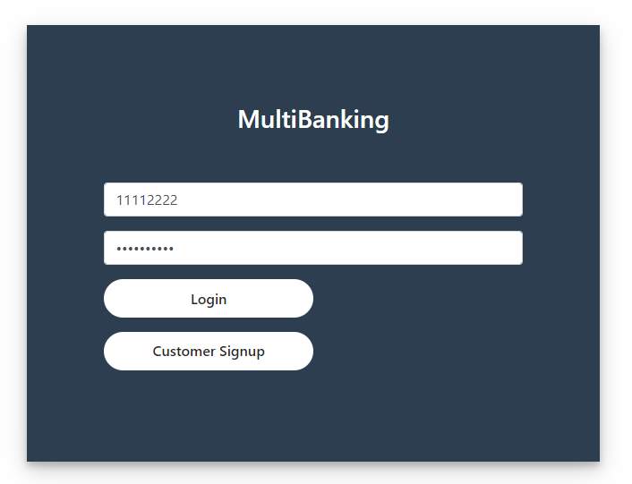
Customer login

Slide 30
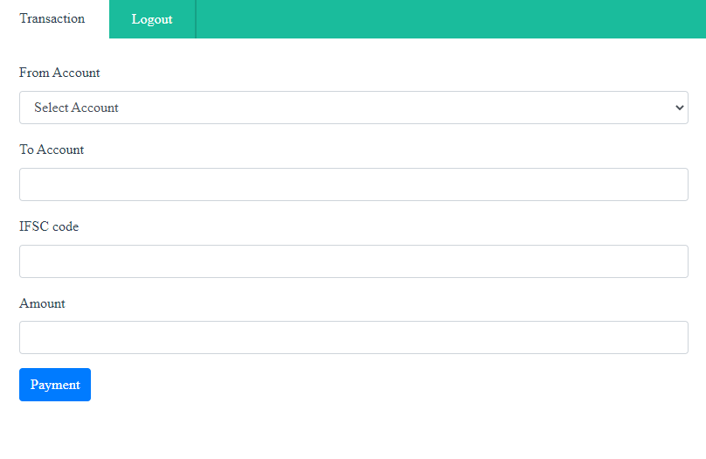
transaction

Slide 31

Thank You

